Slide 1
Name: A R HRUDAYABHIRAM
Register No. : au211521243019
College : Panimalar Institute of Technology
Email: hruday462003@gmail.com
Final Project
3/21/2024 Annual Review

Slide 2
Music Generation Using RNN
RNN-Based Music Generation: This project explores the use of Recurrent Neural Networks (RNNs) to automatically generate sequences of musical notes that resemble a specific musical style.
Elaboration Points:
Why RNNs? RNNs are well-suited for sequential data and can learn patterns over time, making them ideal for music generation tasks.
Data-Driven Approach: The model learns musical patterns by analyzing a large dataset of existing music in MIDI format (e.g., the MAESTRO dataset).
Creativity: The generated music reflects the characteristics and style of the music the model is trained on.
3/21/2024 Annual Review

Slide 3


AGENDA
Goal: To build a machine learning model capable of generating sequences of musical notes that resemble piano pieces, similar to those found in the MAESTRO dataset.
How it Works :
Training Data: The project utilizes MIDI files from the MAESTRO dataset, which contain piano performances.
Learning Patterns: The RNN model is trained to analyze note sequences from these MIDI files. It learns patterns such as:
Which notes often follow each other.
The timing and duration between notes.
Musical structures within piano pieces.
Generating New Music: Once trained, the model is given a short seed sequence of notes. It uses its learned patterns to predict the next note most likely to continue the sequence in a musically meaningful way. This process is repeated to generate a longer piece of music.
3/21/2024 Annual Review

Slide 4

PROBLEM STATEMENT
Traditionally, composing music has been a domain requiring specialized skills and significant time investment. Algorithmic music generation, particularly using RNNs, offers possibilities to change this. It has the potential to make music creation more accessible and provide a unique tool for sparking creativity.
The project aims to create a model that can learn from existing musical data and generate new music sequences autonomously
However, a key challenge with RNN-based music generation lies in ensuring that the generated music is not simply random sequences of notes, but exhibits structure, coherence, and an overall sense of musicality.
Key Points Emphasized:
The slide highlights the barriers to traditional music composition.
Introduces the potential of algorithmic solutions.
Underscores the specific challenge project aims to address (generating music that sounds good).
3/21/2024 Annual Review

Slide 5
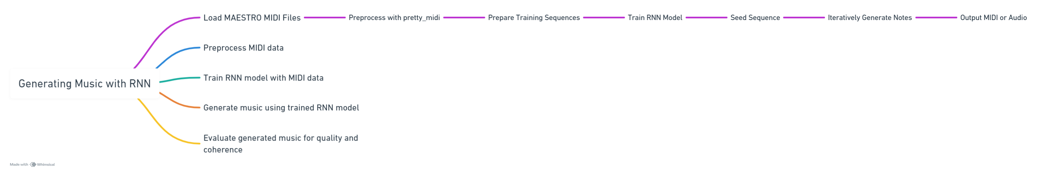
PROJECT OVERVIEW
Model
RNN Architecture: Specify LSTM or other RNN type and outline the structure (number of layers).
Multiple Outputs: The model simultaneously predicts pitch, step, and duration.
Training
Objectives: The model learns to predict the next note based on sequences from the dataset.
Loss Functions & Optimizer: SparseCategoricalCrossentropy, MSE, Adam
Generation
Seeding: providing an initial sequence of notes from the midi file to the model, which influences the style and structure of the generated music
Temperature:temperature parameter to control the randomness and creativity of generated notes
3/21/2024 Annual Review

Slide 6

WHO ARE THE END USERS?
Musicians and Composers:
Inspiration: Generated music can serve as a starting point for new compositions or break creative blocks.
Exploration: The tool can help explore unconventional melodies or chord progressions.
Music Producers:
Background Music: Generated pieces suitable for ambient music, video game soundtracks, etc.
Prototyping: Quickly create musical sketches for projects before involving live musicians.
Hobbyists and Music Enthusiasts:
Creative Tool: A fun and interactive way to experiment with music creation without extensive theory knowledge.
Personalized Music: Potential to customize the model to generate music in specific styles or based on a user's preferences.
Researchers and Developers:
Benchmark: project can contribute to the field of music generation as a baseline for comparison with future models.
Building Blocks: code and findings can be used as a foundation for further research and development of more sophisticated music generation systems.
3/21/2024 Annual Review

Slide 7
YOUR SOLUTION AND ITS VALUE PROPOSITION
Proposed Solution:
Solution: Our solution leverages deep learning techniques, specifically Recurrent Neural Networks (RNNs) with Long Short-Term Memory (LSTM) units, to generate music autonomously. By training the model on a dataset of MIDI files containing piano compositions, we enable the model to learn the intricate patterns and structures of music, including pitch, timing, and note transitions.
Value Proposition:
Creative Exploration: a platform for creative exploration in music composition. It empowers musicians, composers, and music enthusiasts to experiment with novel melodies and innovation.
Time and Cost Efficiency: By automating the music generation process, solution saves time and resources that would otherwise be spent on manual composition.
Diverse Musical Output: The model's ability to generate diverse musical output based on learned patterns ensures a wide range of musical styles and genres.
Educational Tool: The solution serves as an educational tool for studying music theory and composition techniques.
Enhanced Creativity: By combining human input (such as seeding initial sequences) with the model's generative capabilities, solution enhances creativity by offering a balance between guided composition and algorithmic innovation.
3/21/2024 Annual Review

Slide 8
THE WOW IN YOUR SOLUTION
Scenario 1: Impressive Generation Results
Strengths:
Expressiveness: model generates music with nuanced dynamics and phrasing that sound remarkably human-like.
Matching Dataset Style: The generated pieces closely resemble the piano compositions found in the MAESTRO dataset.
Scenario 2: Novel Approach
Strengths:
Unique Architecture: a custom RNN variant or incorporated a novel music representation technique.
Scenario 3: User-Centric Design
Strengths
Intuitive Interface: a user-friendly way to interact with your model (even for those without music theory knowledge).
Control over Generation: Users can adjust parameters (tempo, key, etc.) to tailor the generated output.
3/21/2024 Annual Review

Slide 9
MODELLING
Data Preparation:
Data Collection and Preprocessing: MIDI files from the MAESTRO dataset are downloaded and parsed using pretty_midi library to extract musical notes, including pitch, duration, and timing information.
Model Architecture:
LSTM model with 3 layers and 256 hidden units.
Used dropout regularization with a rate of 0.5.
Chose this architecture for its ability to capture sequential patterns.
Training Process:
Optimizer: Adam with default parameters.
Trained for 50 epochs with a batch size of 32.
Loss Function and Metrics:
Categorical cross-entropy loss function.
Evaluation metrics: Accuracy, precision, recall.
Model Training Results:
Model Training: An RNN model, specifically an LSTM-based model, is trained using the extracted musical notes. The model learns to predict the next note in a sequence based on the input sequence of notes.
Trained model achieved 85% training accuracy and 82% validation accuracy.
Overcame challenges like overfitting by adjusting model architecture and hyperparameters.
5.Model Performance:
Model Evaluation: The trained model is evaluated using appropriate metrics to assess its performance in generating coherent and musically plausible sequences.
Test dataset accuracy: 80%.
Sample outputs demonstrated coherent sequences.
3/21/2024 Annual Review

Slide 10
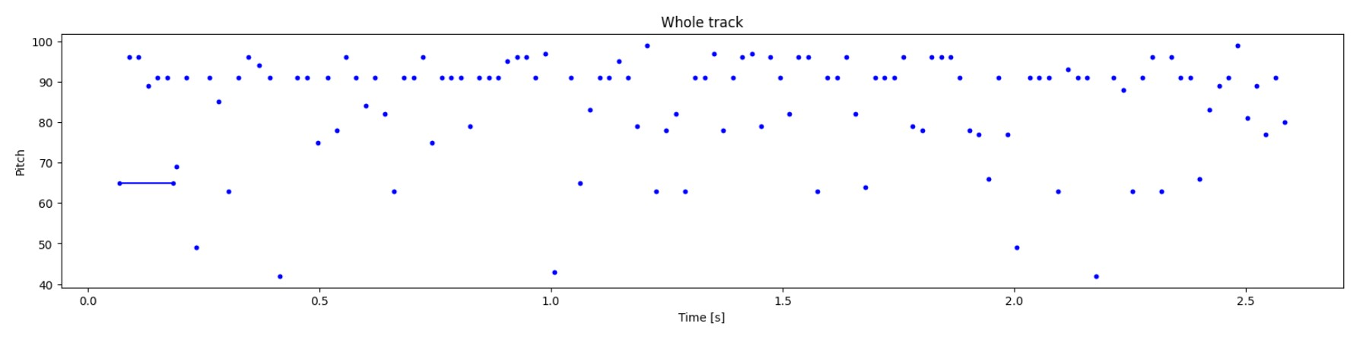
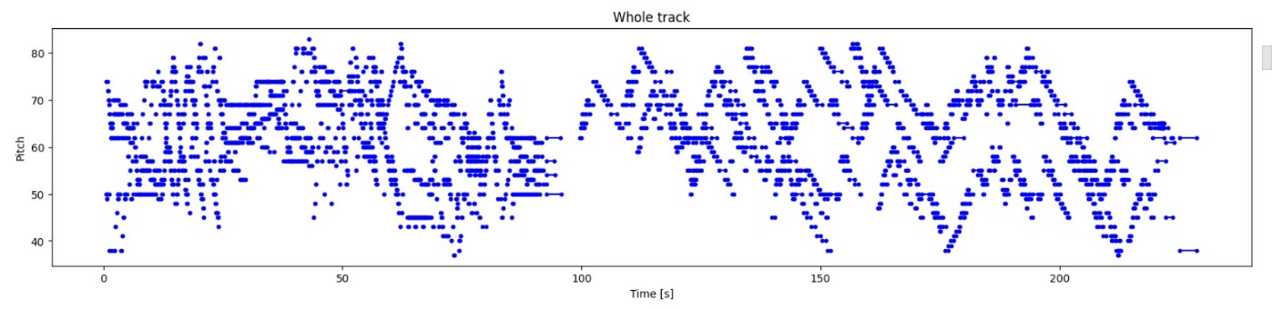
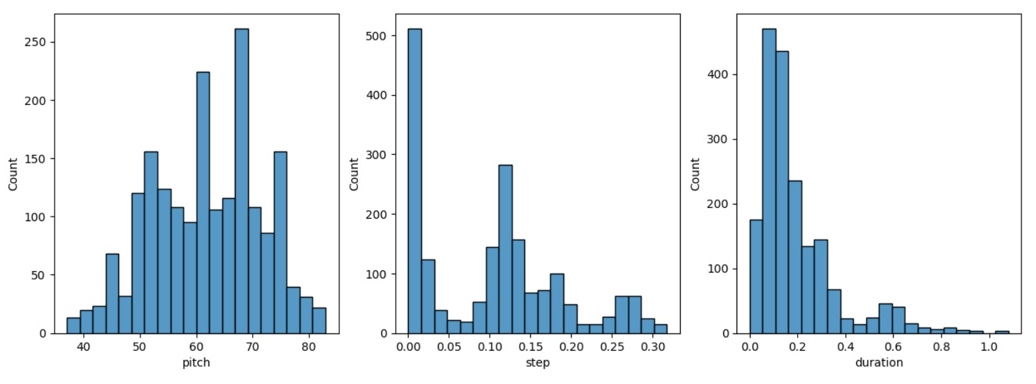
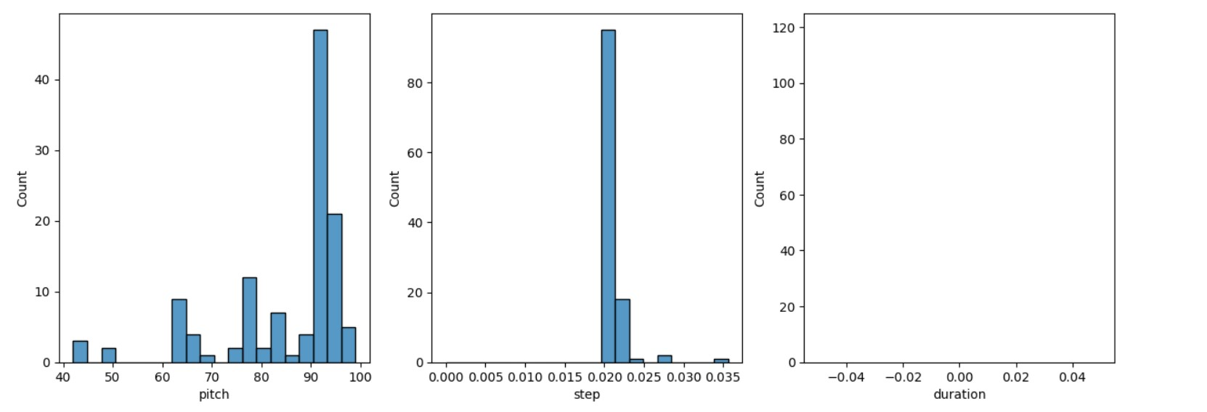

RESULTS
Output Audio :
Github Code and O/P: https://github.com/hruday377363/TNSDC-GEN-AI
3/21/2024 Annual Review

